Slide 1
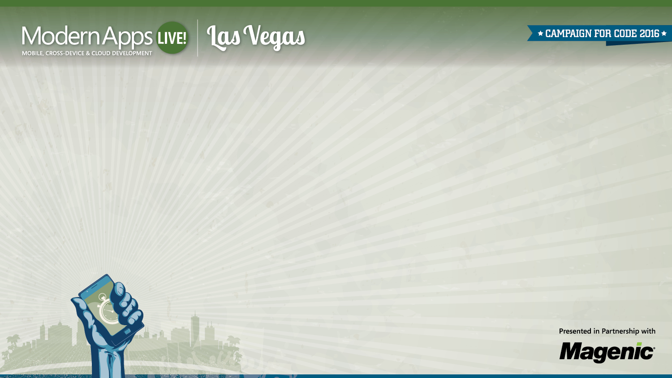
Leveraging Azure Services
Brent Edwards
Principal Lead Consultant
Magenic
Level: Intermediate

Slide 2
Brent Edwards
BrentE@magenic.com
@brentledwards
http://www.brentedwards.net
https://github.com/brentedwards

Slide 3
What We Will Cover
Azure Offerings Overview
How MyVote Leverages Azure Services

Slide 4
Microsoft Azure
10,000 ft View
Notes:
[DEMO]
MyVote is a multi-platform voting app.
You can create a poll, take a poll, and see the results of polls.
Polls can have images and they are stored in Azure Blob Storage.
When a user signs up, they fill out some basic info. This allows us to do some demographic data mining.

Slide 5
Azure - 10,000 ft View
IAAS – Infrastructure as a Service
PAAS – Platform as a Service
SAAS – Software as a Service
Notes:
IAAS – Server and VM needs
PAAS – Websites and SQL Server
SAAS – Web Apps hosted with Azure

Slide 6
Azure Benefits
Scalability
Redundancy
Availability
Manageability

Slide 7
Virtual Machines
Windows and Linux
Scalable
Built-in load balancing
Provisioned with a button click

Slide 8
Cloud Services
Auto-scalable APIs
Create staging environments
Integration with Visual Studio
Templates with different focuses
Web Apps
Mobile Apps
API Apps

Slide 9
SQL Databases
Scalable
Replicated
Manage with SQL Server Management Studio

Slide 10
Storage
Plenty of space
Redundancy
Performance
Fees scale with usage
Accessible via REST API

Slide 11
MyVote
A Modern App
Notes:
[DEMO]
MyVote is a multi-platform voting app.
You can create a poll, take a poll, and see the results of polls.
Polls can have images and they are stored in Azure Blob Storage.
When a user signs up, they fill out some basic info. This allows us to do some demographic data mining.

Slide 12




MyVote App Architecture
HTML 5 UI
iOS UI
UWP UI
Android UI
JavaScript BL
BL
BL
BL
Service Proxy
Data Portal
Data Portal
Data Portal
Reports
SQL Reporting
REST API
Data Portal
ASP.NET WA
BL
Excel
DAL
PowerPivot
SQL Database
Blobs

Slide 13
MyVote Server Technologies
ASP.NET MVC
Azure
SQL Server
CSLA
Notes:
ASP.NET MVC4 drives the REST API and the Web client.
CSLA is the business object framework we use for the business logic.
Azure for web hosting as well as blob storage
SQL Server 2012 for the database

Slide 14
MyVote Client Platforms
Web
Android
iOS
Windows

Slide 15
Myvote From the ground up

Slide 16




Azure
MyVote
SQL Server Database
Blob Storage
Mobile Services/Mobile Apps
Website

Slide 17
Azure sql server database

Slide 18
Azure SQL Server
SQL Server Data Tools (SSDT)
Create Visual Studio Database Project
Can check into source control
All devs have access
Can publish right from Visual Studio

Slide 19
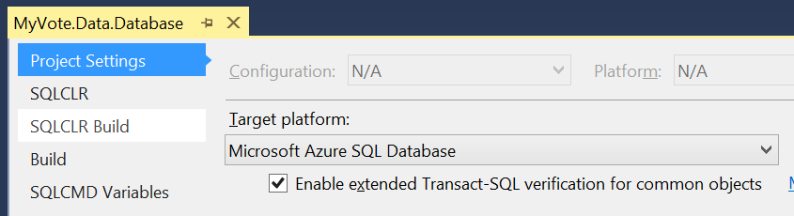
Azure SQL Server
Target Platform: Microsoft Azure SQL Database

Slide 20
Azure SQL Server Database
[DEMO]

Slide 21
Azure storage

Slide 22
Blob Storage
Store Poll Images as Blobs
Give upload access on-demand
Generate Storage Access Security (SAS) Key

Slide 23
Storage Access Security (SAS)
What is it?
Temporary key
Has built-in expiration
SAS keeps credentials out of client
Recommend generating on server

Slide 24
Azure Storage
A Couple of Options For Apps
Nuget Package
Windows Azure Storage
REST API

Slide 25
Windows Azure Storage Library
Nuget Package
Gives access to containers and blobs
Can use credentials directly
Better yet, use SAS

Slide 26
REST API
Provides all Blob Storage functionality
Create containers
Upload blobs
Can use credentials directly
Better yet, use SAS

Slide 27
Azure blob storage
[DEMO]

Slide 28
Azure Websites

Slide 29
Azure Websites
ASP.NET MVC
Web API
Hosts
CSLA DataPortal
REST API
Web App

Slide 30
Azure Mobile Services/ Azure Mobile Apps

Slide 31
Azure Mobile Services
Primary Features
Authentication
Push Notifications

Slide 32
Azure Mobile Apps
Azure Website configured for Mobile apps
Web API
Authentication
Can check into Source Control
Can debug on server

Slide 33
Web API
[MobileAppController] Attribute on Controller
Registers route
Sets up Mobile Apps JSON Serializer

Slide 34
Authentication
oAuth done easy
4 Auth Options
Twitter
Facebook
Microsoft
Google
Biggest Drawback
Users have to remember which option they chose

Slide 35
Authentication
Things to consider
Is your app open to anyone?
Does your app need domain authentication?
If so, Azure Mobile Services is probably not the best option for auth

Slide 36
Push Notifications
Deliver info to your users through notifications
Tile
Badge
Toast
Things to consider
How can your Tile be more Live?
What info to show in Toasts?

Slide 37
Azure Mobile Services
Can create project in Visual Studio
Add SAS key generation code
Check into source control
Can remotely debug on the server

Slide 38
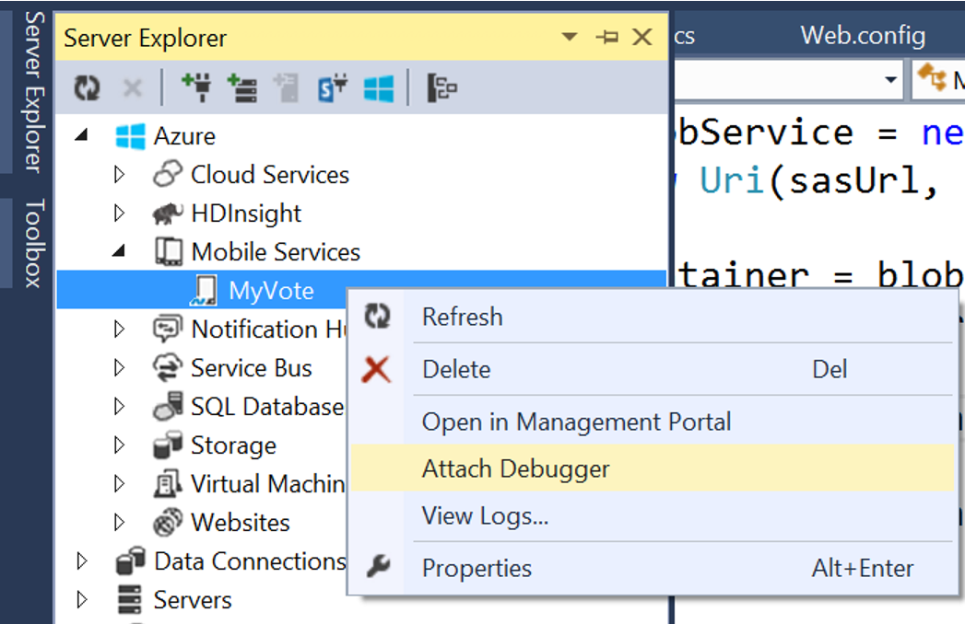
Azure Mobile Services

Slide 39
Azure Mobile Services
[DEMO]

Slide 40
Info
MyVote Source
https://github.com/magenic/myvote

Slide 41
Questions?

